Slide 1
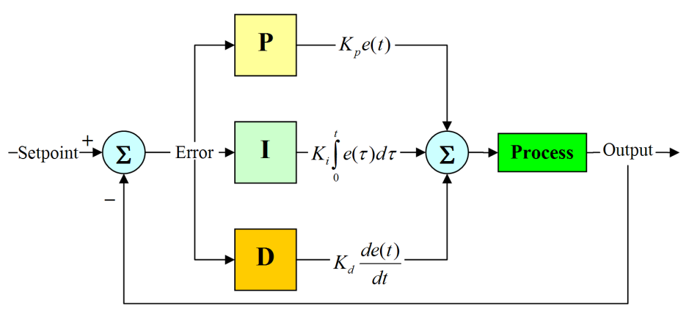
CONTROL THEORY REVIEW: PID CONTROLLER
PID controller algorithm: proportional (P), integral (I) and derivative (D)
P: depends on the present error
I: accumulation of past errors
D: prediction of future errors, based on current rate of change
The weighted sum is used to adjust the process via a control element (control valve)

Slide 2
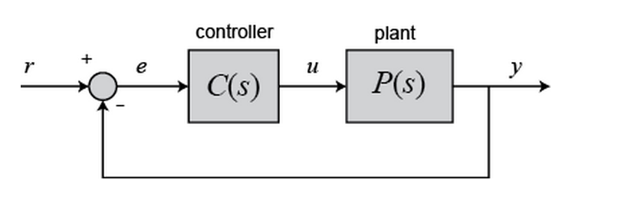

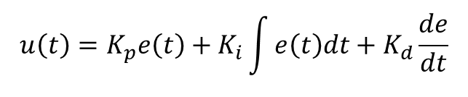
CONTROL THEORY REVIEW: PID CONTROLLERS
$$u\left(t\right)=K_{p}e\left(t\right)+K_{i}\int{e\left(t\right)dt}+K_{d}\frac{de}{dt}$$
Consider a unity feedback system
e: error signal
r: desired input value
The PID controller in a transfer function form:
$K_{p}+\frac{K_{i}}{s}+K_{d}s=\frac{K_{d}s^{2}+K_{p}s+K_{i}}{s}$
http://ctms.engin.umich.edu/CTMS/index.php?example=Introduction&section=ControlPID

Slide 3
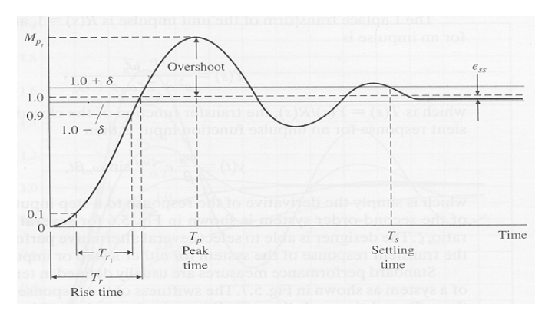
CONTROL THEORY REVIEW: SYSTEM PERFORMANCE PARAMETERS
Percentage overshoot measures how close the system response to the desired response.
Settling time is the time required for the system to settle within a certain percentage of the input amplitude.
For second order systems, desired response remains within 2-3% of the final value.

Slide 4
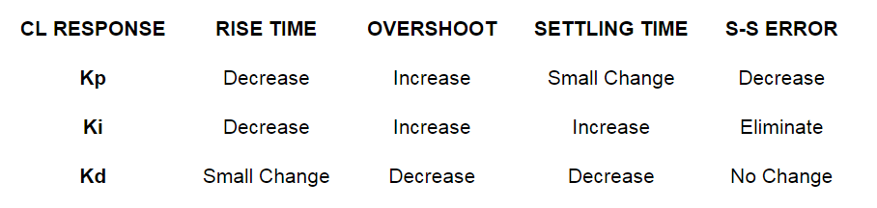

CONTROL THEORY REVIEW: PID CONTROLLERS IMPACT ON SYSTEM RESPONSE
$K_{p}$: reduces the rise time and the steady state error but will never eliminates the steady-state error.
$K_{I}$: eliminates the steady-state error for a constant or step input
$K_{d}$: increases the stability of the system and reduces the overshoot
http://ctms.engin.umich.edu/CTMS/index.php?example=Introduction&section=ControlPID

